Slide 1

Integrating Inquiry into science education STEM & Science Fair
Michelle
Mardahl
Bonita Vista HS
15 years Sci Fair Advisor
Club Advisor Science & Engineering Club

Slide 2


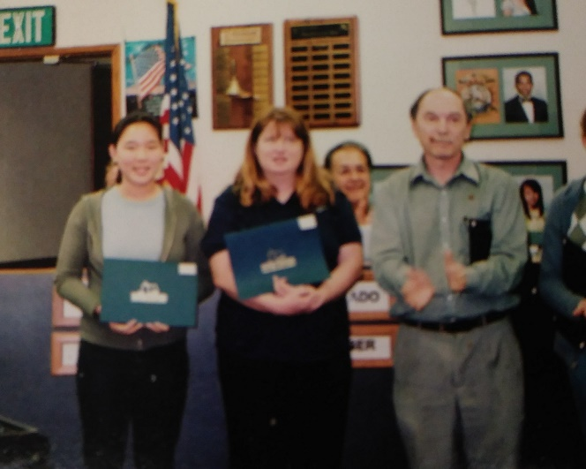
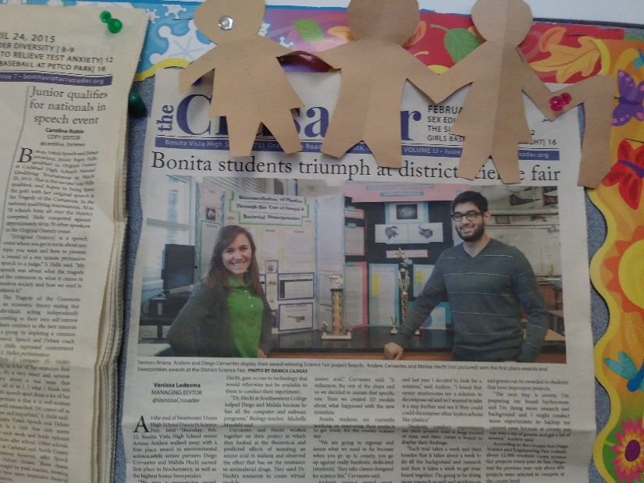
Why did I get involved?
15 years ago Sonia Kim asked me! Now at Harvard MD-PhD Sci Fair was her hobby
Renae Cruz- earning PhD at U of Washington
Mailyn Nashiguchi- earning PhD at U of Penn (passed orals)
Arianna Andere- Undergrad research at Brown- publishing 1st author paper this spring
Victor Escobedo & Diego Cervantes, Malida Heck, Leib Lipowki UCSD, USC, SDSU & UCD undergraduate research

Slide 3
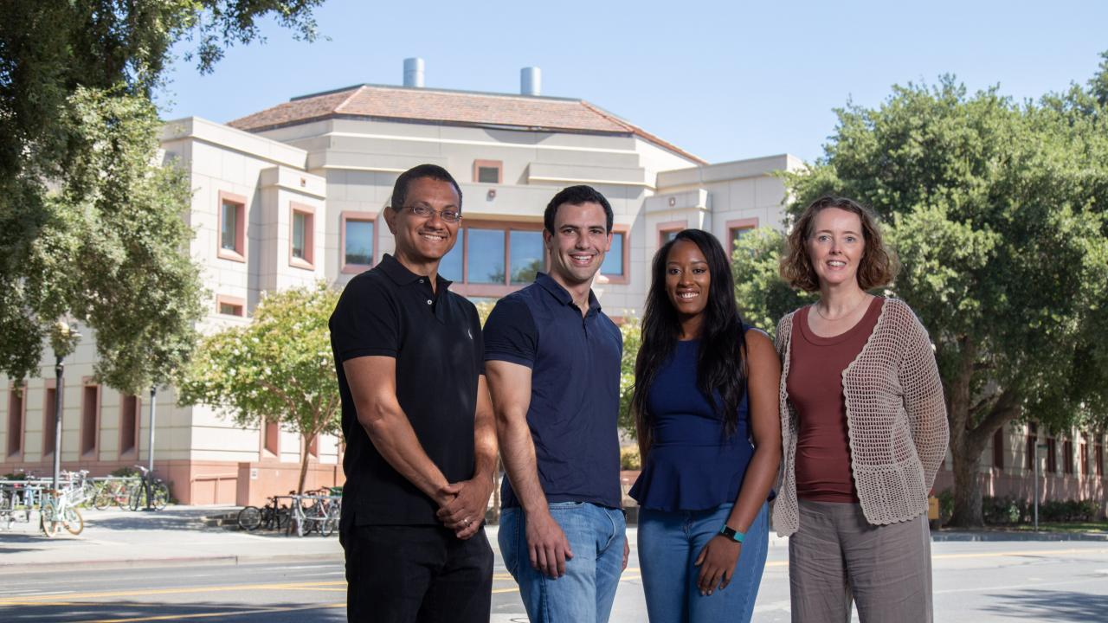
Leib at UCD Undergrad Research

Slide 4
Adding Inquiry into Science classes is a STEM goal
Choice of a variable- list of potential ones or open ended but Hypothesis based
Give general directions then modify method to investigate a factor of their choice
Planning lab- student is given an objective only. They design method, determine the materials needed
Students are introduced to a piece of equipment or supply and design their own experiment

Slide 5

Pros & Cons
Students need more time!!!
Need a lower student to teacher ratio to properly supervise beginning stages and offer timely feed-back
Equipment
Prep time
Promote student engagement
Encourages student directed learning and academic language development in collaborative working groups
Uses problem solving, critical thinking skills such as analysis, application, synthesis, evaluation

Slide 6

FAQ:
How much of the grade a STEM Project constitutes in your class
Timelines
How much extra time you spend…
How you grade your STEM projects.
How you determine which projects to send on to the District STEM Fair..

Slide 7

IB program requires students plan and execute their own personal projects – 20% of the IB Science test
I let them have 2 weeks of class to complete it
Open ended- whatever topic they wish to pursue as long as we have materials & equipment
EC if they bring to science fair for IB HL biology
AP biology (All AP Sciences should!) also has inquiry components- but AP bio students they have to come in extra to complete 3 trials for science fair
Emphasis on Hypothesis Based Scientific Method and not Discovery Science

Slide 8
FAQ:
How much of the grade a STEM Project constitutes in your class
ACC biology planning group lab is ~ 5% of their grade semester 2; IB biology ~10% of grade Semester 2
4) Handouts/web info you use to introduce the STEM Project.
Expectation general information give planning guide
5) Timelines
ACC biology give a month of class time
6) How much extra time you spend… Depends on the individual
7) How you grade your STEM projects. - Given rubric
8) How you determine which projects to send on to the District STEM Fair..
Anyone that wants to go has been accepted. Problem to motivate High school students

Slide 9
Name_____________________________________________
Science Fair Planning
Sample Science Fair notebook: https://www.gsdsef.org/sites/default/files/gsdsef-sample-notebook-rev-for-2018.pdf-_0.pdf
Topic- Main idea that you want to study
Need at least 10 sources for background- attach bibliography.
Attach Parent permission form
Materials needed
What is being measured?
How are you setting up a control experiment?
General procedure

Slide 10
I. Introduction AT least 1 page in length 5 pts
Purpose-short statement
B. background - Explain the human impact and effect on the environment (cite reference such as Drews,2002) 1 pt
Explain your experimental variable, how much is in the environment ppm (cite source) 1 pt
The specific harm it may cause on your experimental organism.
Background on your experimental organism + at least 3 correct citations 1 pt
C. hypothesis-I predict _____ because _____( explanation for your prediction) 1 pt
II. Procedure- (At least 1 page in length separate this from part I) 8 pts
Materials- list all equipment and materials; Specify size, dimensions, brand, type of material needed 2 pts
Method- STEP by step detail exactly how you set up lab so anyone else can repeat it -repeat/label groups ; List exactly what to measure how to measure and when to measure and how many trials 3 pt
C. Table of Variables
Independent Variable- 1pt
Dependent Variable- what you are measuring & units 1pt
Controlled Variable – what is kept the same and how and why you kept it the same between exp. & control plate. Need at least 4 ways in which the control will be the exact same treatment as the experiment. What can not be controlled? 4 pts

Slide 11
Formal Lab Guidelines
Title- use a complete sentence stating outcome or purpose of lab
I. Introduction
A. Purpose-short statement
B. background and theory- short paragraphs, predict results and cite sources (ex: Mader, 2001)
C. hypothesis-needs to have an explanation for your prediction
II. Procedure-
A. Materials- list and or drawings
Method- refer to handout and draw a flowchart in enough detail so it can be repeated
SAFETY considerations- eye-ware, disposal of reagents, products
D. Table of Variables
Independent Variable- that which you will change in the experimental group- what you are testing for
Dependent Variable- what you are measuring
Controlled Variable explain how and why these are kept the same (NOT just to get accurate results!)
Uncontrolled variables- what you could not control
III. Results- Number Tables and Graphs-(6pts)
A. Data
1. Qualitative – make observations –color/smell/see or note changes
2. Quantitative- Chart measured data (height/weight/number) include units & limitations
(ex. 10.0 g +/- 0.1 g)
B. Data Analysis- Transformed Data- Graphs/Tables/charts/ Statistics-
Show Sample Calculations- Data is transformed by calculating the total/averaging/ rates/ percent change.
Graphs must have a Title/ Labeled X axis (independent variable) Y axis (dependent variable) include units with a legend showing both the control and experiment. Error Bars show +/- limitations in standard deviation for class average or note uncertainty.
Column Graphs used to compare data. T-TEST
Line Graphs used to show differences over time or dosage- connect points in best fit & perform r2
IV. Conclusions and Discussion (at least 1 page in length)-(3pts)
A. Summary-how did you change a variable and what was the effect?
B. Interpretations of data

Slide 12
Advisor Responsibilities
submitting and signing paperwork. If the project was done at school, the sponsor is also responsible for active supervision of the experimentation.
evaluate any possible risks involved in order to ensure the health and safety of the student conducting the research and the humans and/or animals involved in the study.
must review the student’s Project Proposal Plan and ensure that:
a) experimentation is within GSDSEF rules and regulations, fed, state laws
b) Certification forms required are completed and signed
c) parent permission forms before the student begins the project;
keeps on file student’s Project Proposal and any other needed completed/signed Certification forms.
ensures students follow all deadlines.
Sample notebook at https://www.gsdsef.org/sites/default/files/gsdsef-sample-notebook-rev-for-2018.pdf-_0.pdf

Slide 13
