Slide 1
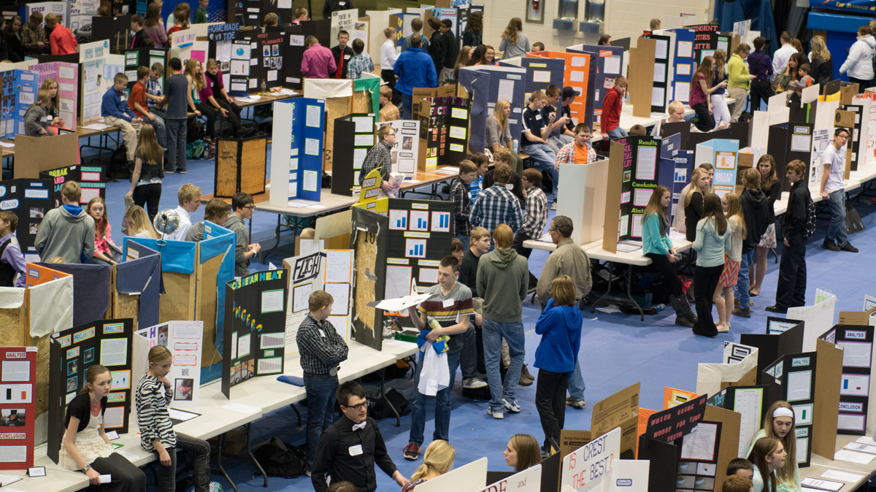
Science Fair Project

Slide 2
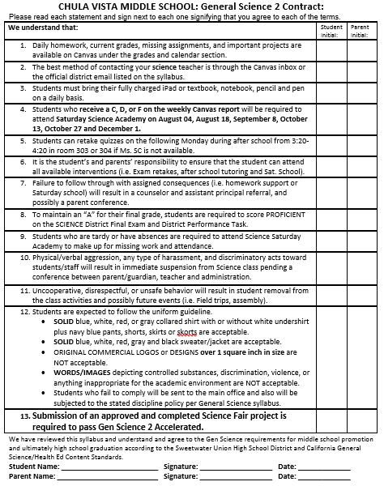
All GS 2 Acc students are required to turn in an approved Science Fair project.
Parents and students signs the syllabus contract agreeing that failure to turn in an approved Science Fair Project will result in a failing grade.

Slide 3
Science Fair Writing Academy
Students are invited to attend four Saturdays of Science Fair Writing class during the month of August
Contact your CIS Coordinator for questions about funding.

Slide 4
Grading Timeline for First Semester
First 6 weeks
Title, Question, Background Information, Hypothesis, Materials and Procedures.
Second 6 weeks
Pictures of experiment set up, data chart, graphs, analysis and conclusion.
Third 6 weeks
Complete type written report (first draft)

Slide 5
Grading Timeline for Second Semester
First 2 weeks
Students turn in final report and create display board.
Last Friday in January
Students participate in the Chula Vista Science Fair.
All CVM Science student view the exhibits and vote for the best 30.
Science Fair advisers makes the final list of students who will participate in the SUHSD Science and Engineering Fair.

Slide 6
Final Grade for 2nd Semester
Students are guaranteed to pass GS 2B Acc provided they receive a passing score on the performance task and final exam.
Students who qualify for the GSDSEF are guaranteed to receive an “A” provided they receive a passing score on the performance task and final exam.

Slide 7
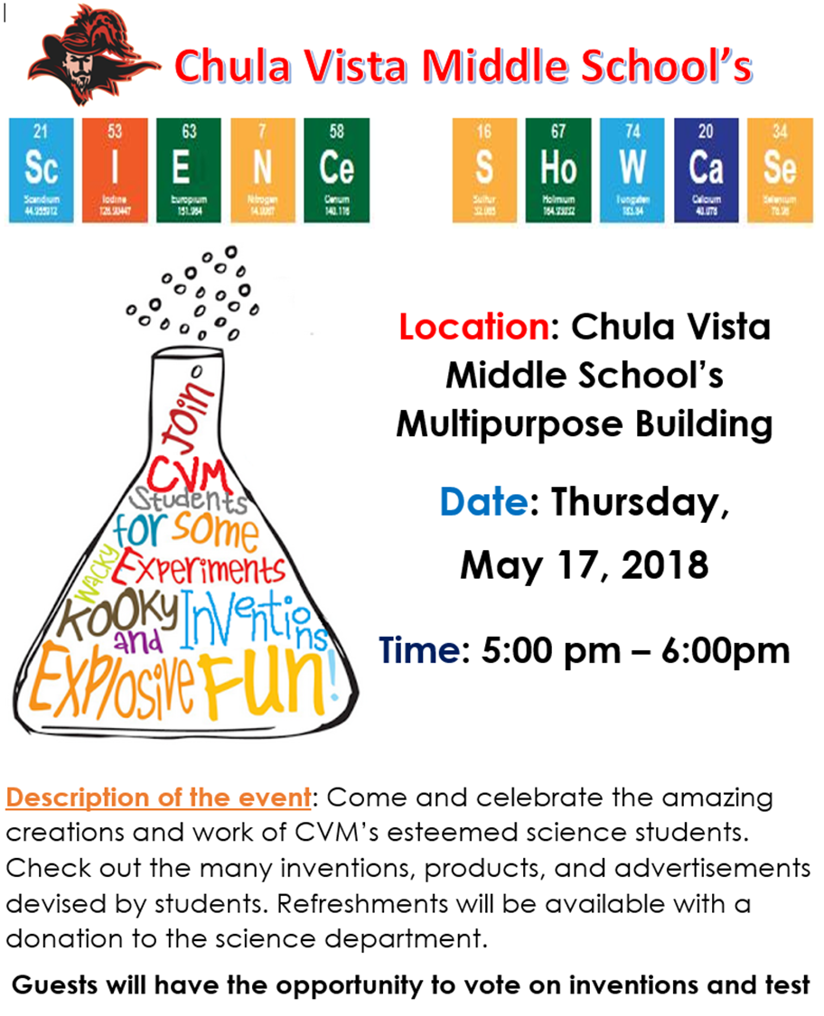
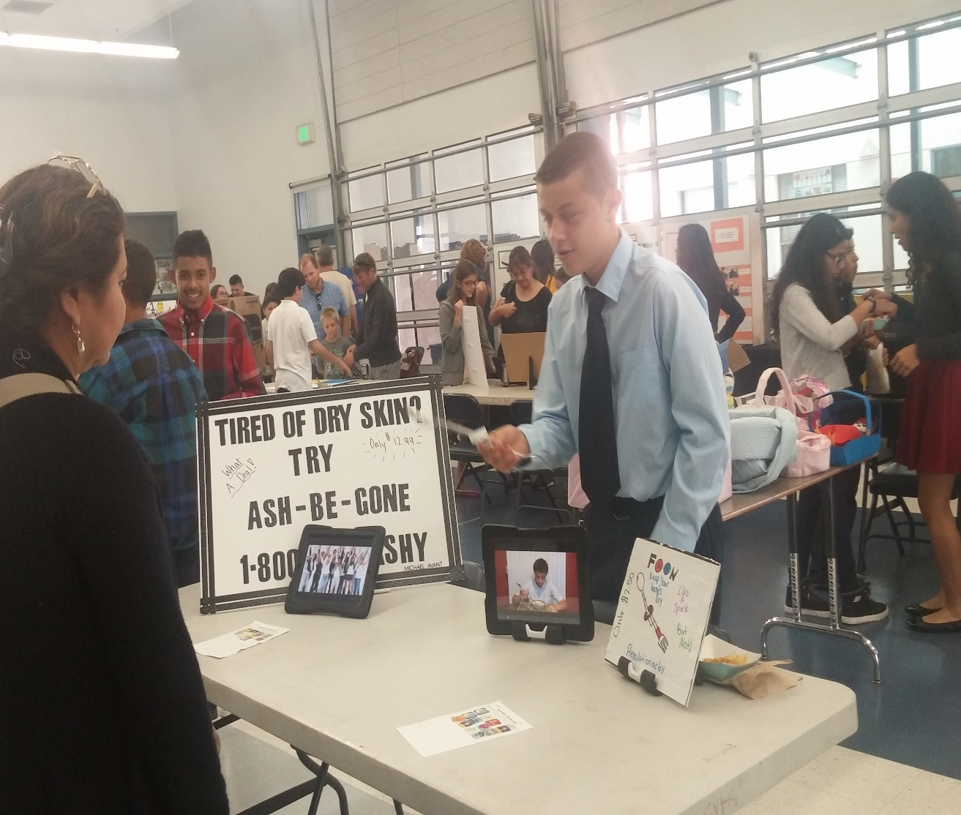
CVM Science Showcase

Slide 8
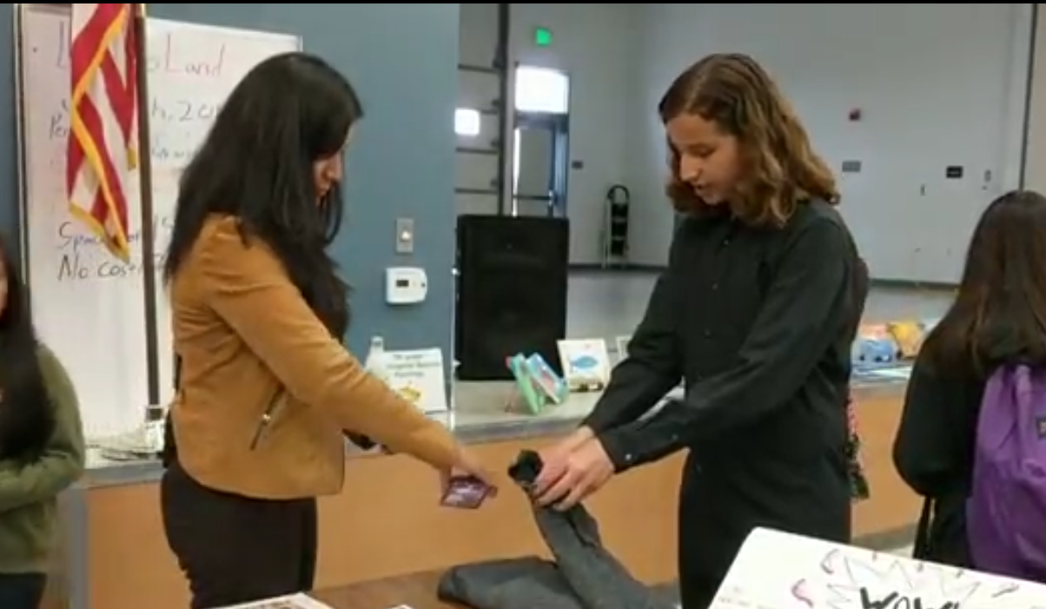
CVM’s Science Showcase
Enables school staff, administrators, parents, family, and district officials to view the Engineering Design Projects 7th and 8th grade Science students have completed over the semester

Slide 9
More Details
7th Grade Accelerated final Engineering Design Project is to design an invention, matching advertisement, and commercial for their product for Science Showcase
Students will be telling attendees about their invention.
  They are required to present to at least 15 different individuals.
Students are required to invite their parents or a guest to attend the event to receive homework credit.
The Event is only one hour, engineering design projects will be on display for attendees to interact with

Slide 10
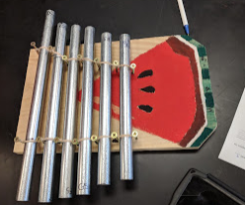
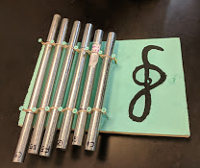
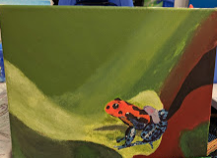
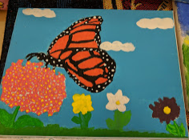
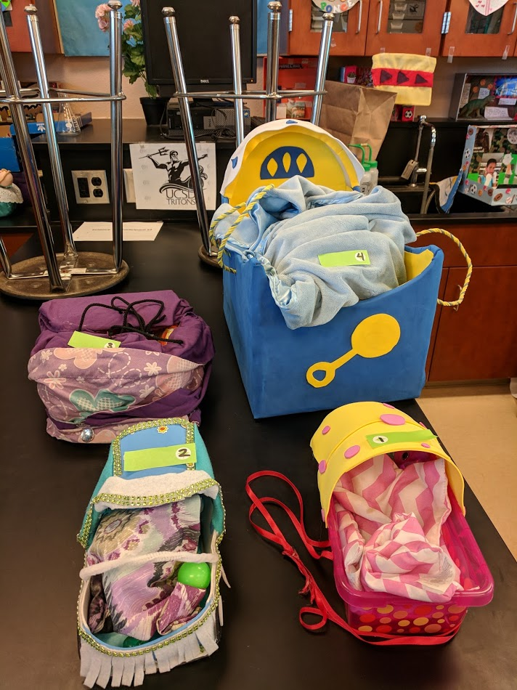
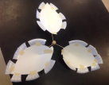
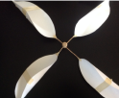
Engineering Design Projects at the Event
Metallophones
Endangered Specie Painting
Baby Carriers
Wind Turbines

Slide 11
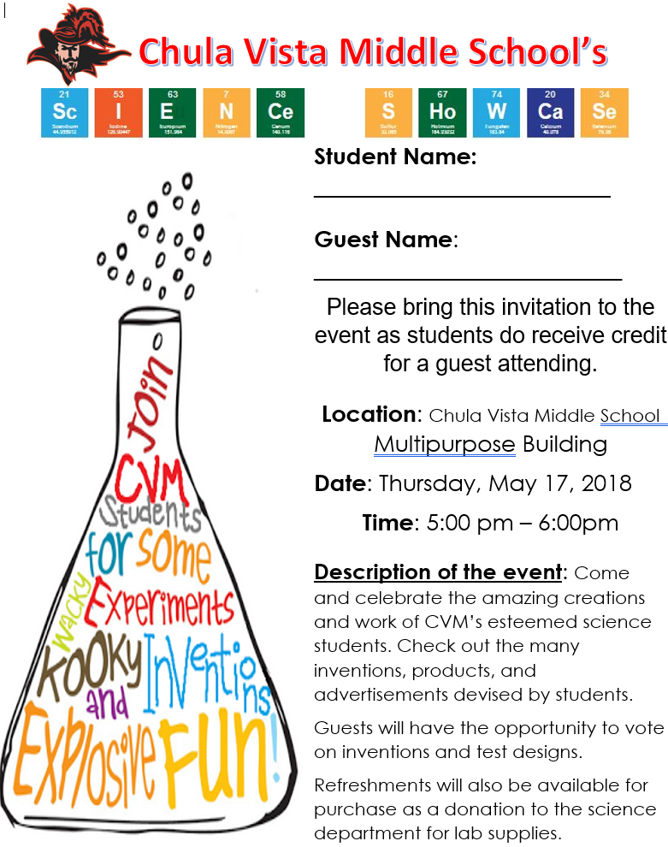
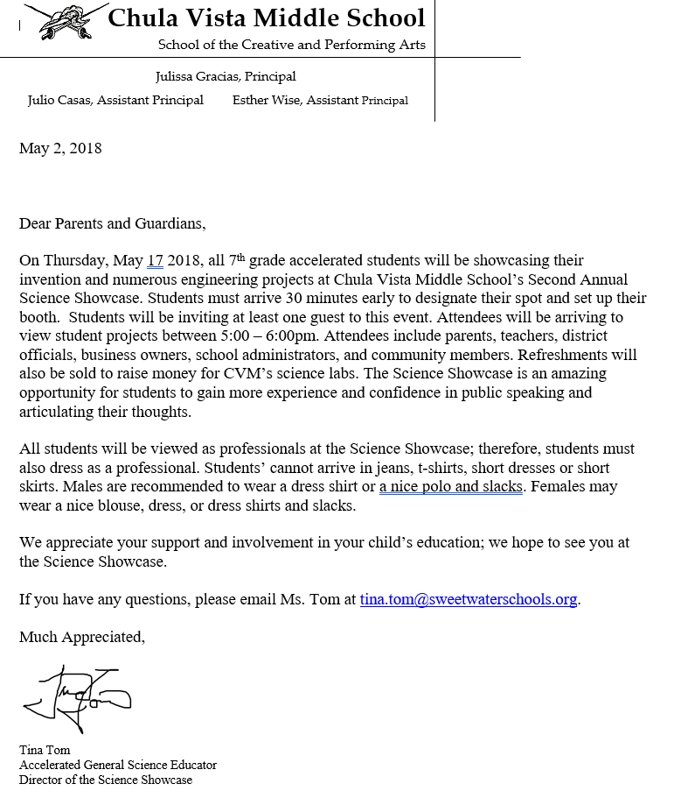

Slide 12
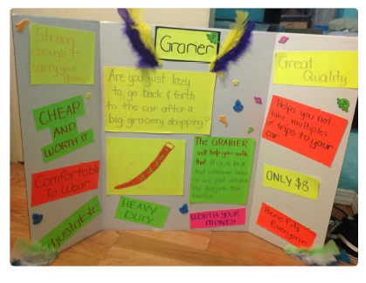
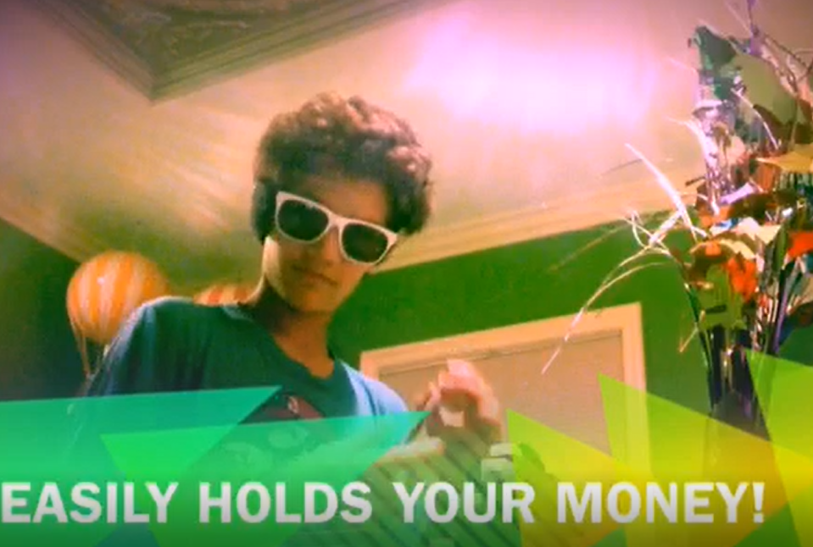
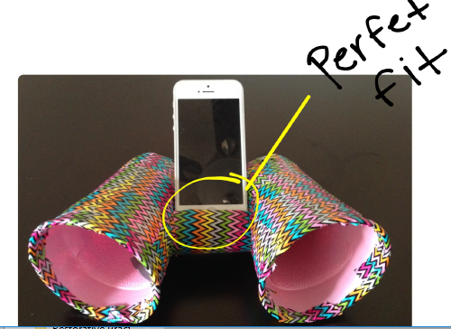
Infomercial or Commercial
Invention Advertisement
Invention

Slide 13
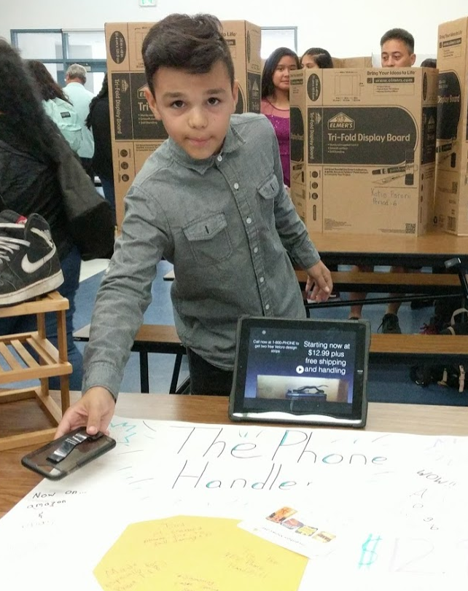
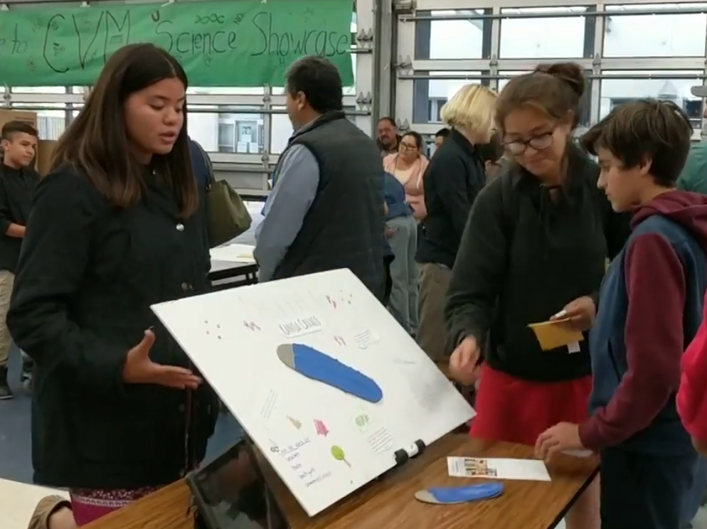
Students have the opportunity to practice public speaking and advocating for their product

Slide 14
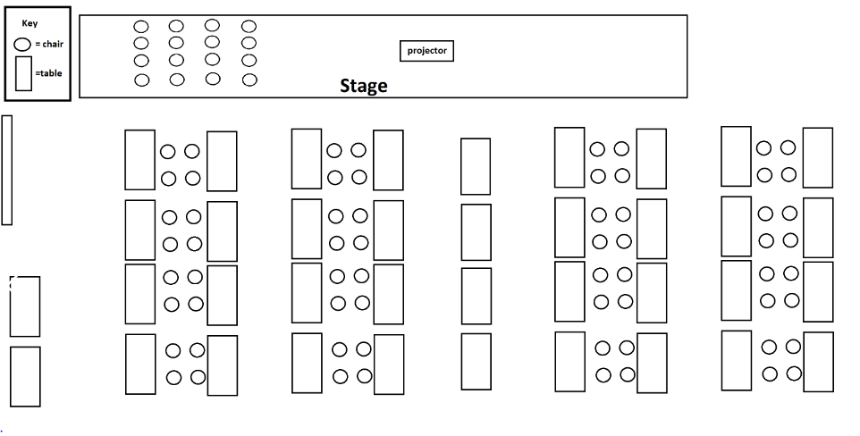
Science Showcase Layout

Slide 15
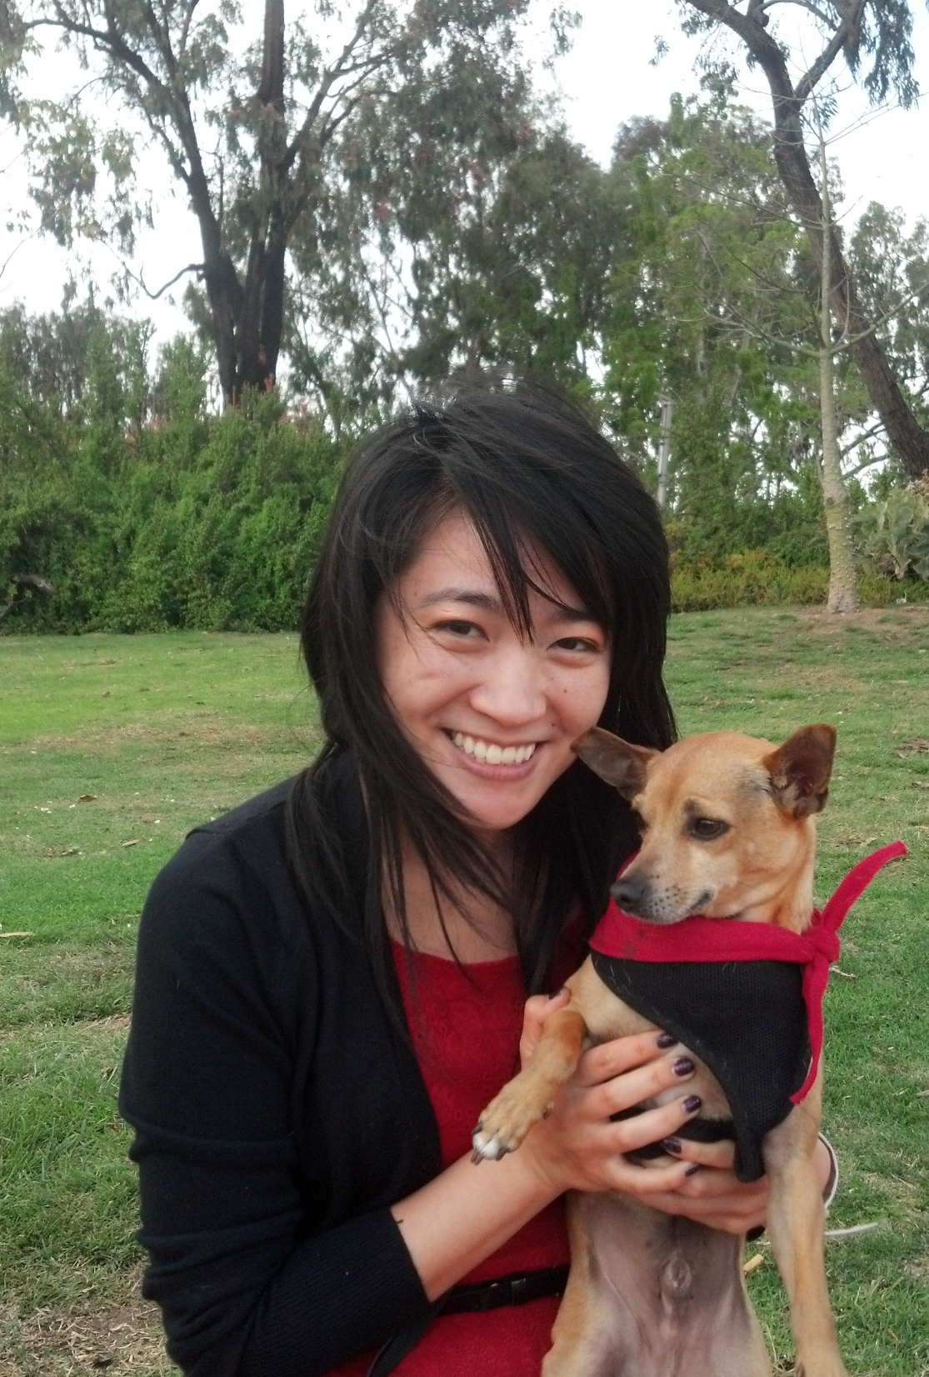
Have more questions about the
Science Showcase or Engineering Design Projects?
Contact:
Tina Tom
tina.tom@sweetwaterschools.org

