Slide 1
68th Annual
Greater San Diego
Science & Engineering Fair
Virtual Awards Ceremony
March 17th, 2022

Slide 2
Welcome to the 68th Annual
Greater San Diego Science & Engineering Fair
Virtual Awards Ceremony
March 17th, 2022
Introduction of Keynote Speaker
Steve Rodecker

Slide 3
Sponsors

Slide 4
Welcome to the 68th Annual
Greater San Diego Science & Engineering Fair
Awards Ceremony
March 17, 2022
Director’s Remarks
Steve Rodecker

Slide 5
Special Thanks and Gratitude to the Management Committee
BOARD OF DIRECTORS:
Dr. Earl Williams, Naval Information Warfare Systems Command, GSDSEF Board President
Mrs. Vickie Driver, Zim Biosciences
Dr. Donna Kritz-Silverstein, UCSD
Mr. William Proffer, Leidos, retired
Mr. Sam Ferguson, University of Georgia Graduate School
MANAGEMENT COMMITTEE:
Steve Rodecker, Fair Director  Sany Zakharia, Treasurer, Fundraising
Vickie Driver, Judging  Earl Williams, Grand Award Judging, Tech  Rose Armour, Screening Coord
Dale Clarke, Technology/Website  Sejal Pabari, Professional Societies
Sam Ferguson, Awards AV  Douglas Smith, Hospitality  True Xiong, Volunteers
Jessica Ullyot, Screening, Store  Donna Kritz-Silverstein, Screening  Laura McWilliams, Screening
William Proffer  Diane Vermeulen  Hal Slater

Slide 6
Special Thanks and Gratitude to the Teachers

Slide 9
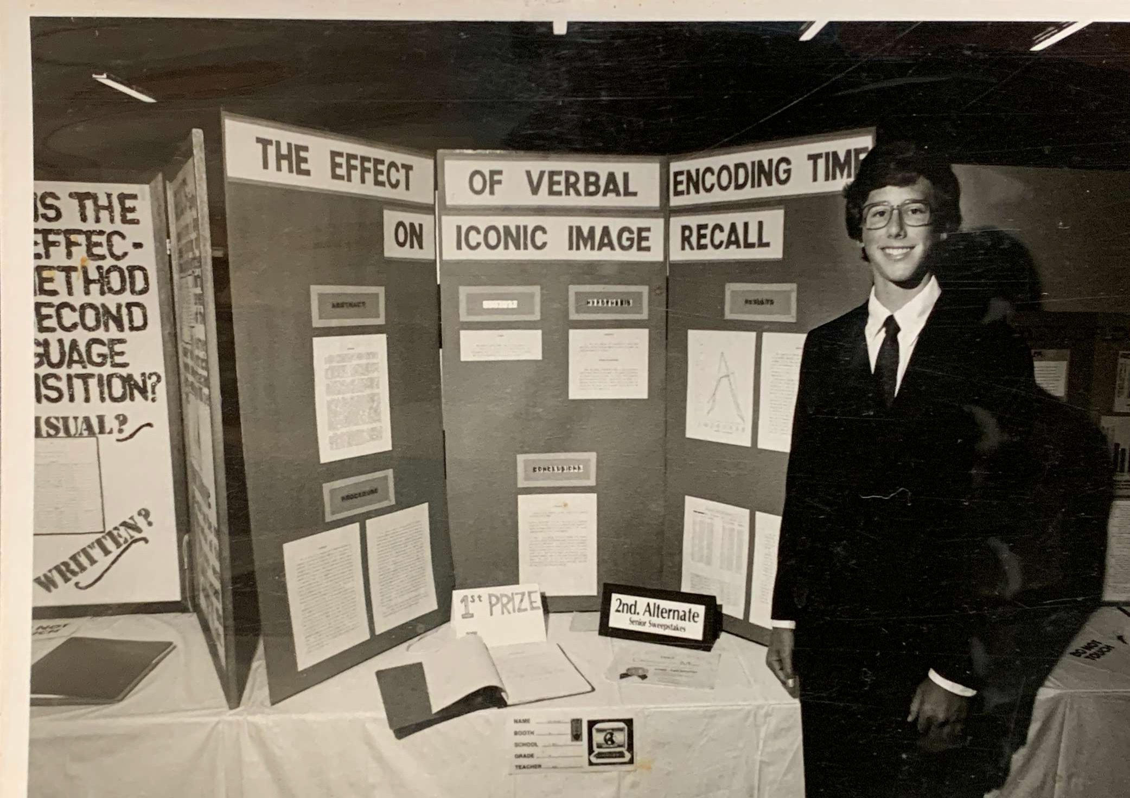
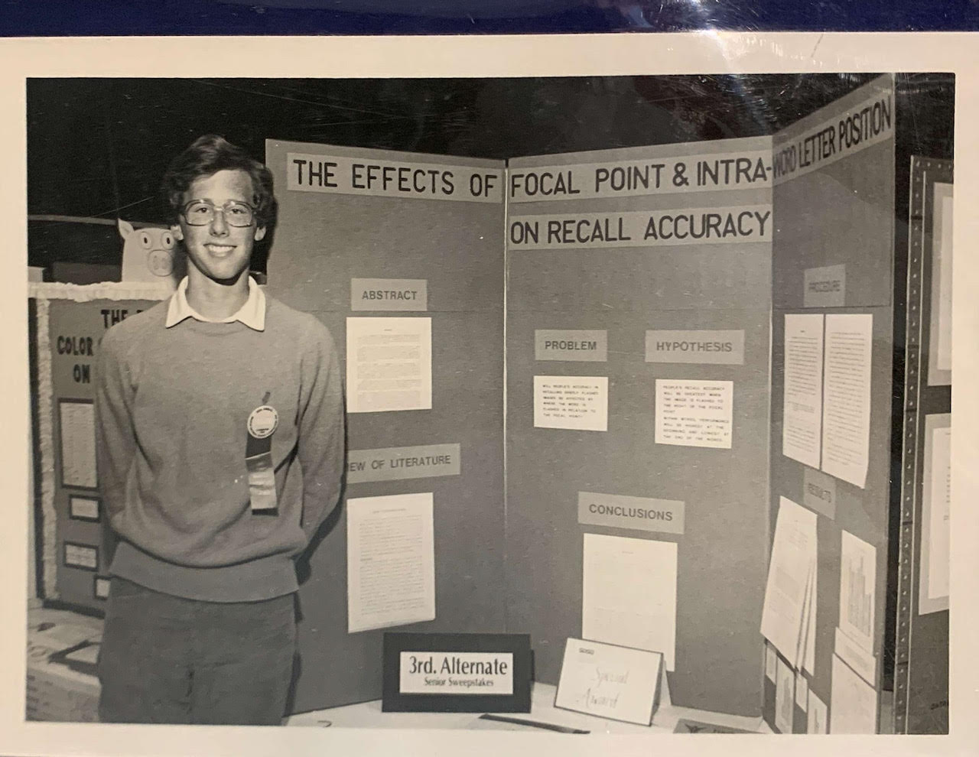
Dr. Earl Williams
GSDSEF Board of Directors, President
Naval Information Warfare Systems Command

Slide 10
Introduction
of
Awards

Slide 11
Pickup Days
No mailing of awards
Pick up awards on Friday from 3:00pm – 6:00pm, Saturday 10:00am – 1:00pm, and Sunday from 12:00pm – 3:00pm at Balboa Park Activities Center (BPAC)
Pre-ordered T-Shirts can be picked up with award
Showcase is available on zFairs
Additional Awards information will be available on the GSDSEF website Sunday

